Slide 1


RENN: Efficient Reverse Execution with Neural-network-assisted Alias Analysis
Dongliang Mu, Wenbo Guo, Alejandro Cuevas, Yueqi Chen, Jinxuan Gai, Xinyu Xing, Bing Mao, Chengyu Song
Nanjing University & Penn State University & University of California, Riverside
Notes:
Thanks for the introduction. Good afternoon, everyone. My name is Chengyu Song. It’s my honor to present our paper - RENN: Efficient Reverse Execution with Neural-network-assisted Alias Analysis. This is a joint work with collaborators from three universities – Nanjing University, Penn State University, and University of California, Riverside.

Slide 2
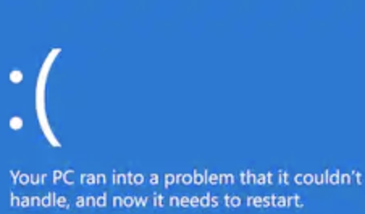
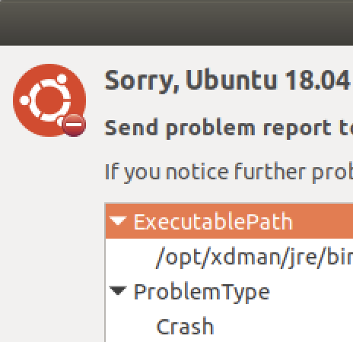
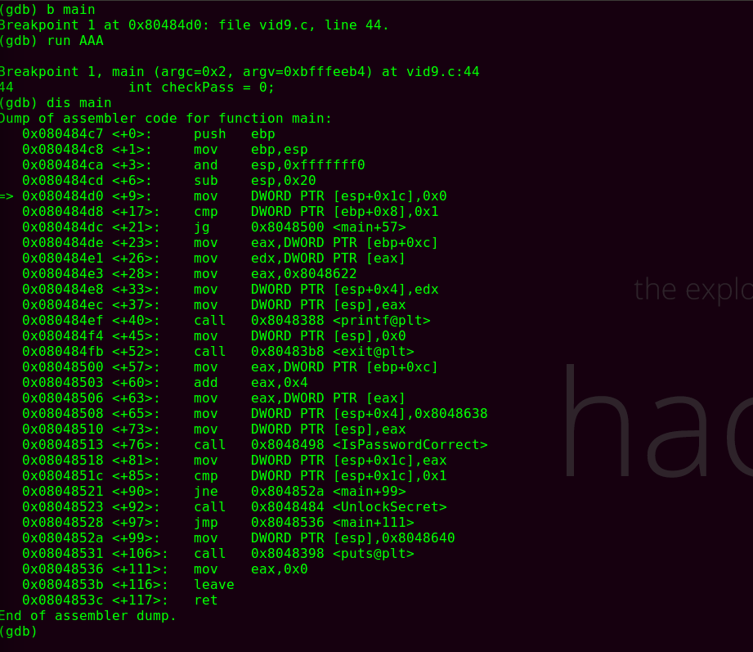

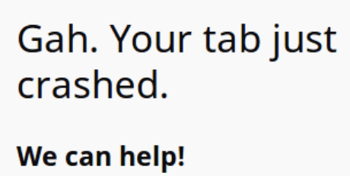
Software inevitably contains defects
Software defects are prevalent and inevitable
When triggered, those software defects could cause runtime failure
It’s urgent to diagnose those runtime failure in a timely manner
Notes:
First, let’s introduce some background. Despite the best efforts of software developers, it is inevitable for software to carry defects. When those defects are triggered, software will crash or terminate abnormally, which leads to runtime failure. To reduce the damage and prevent further exploitation, it is urgent for developers to identify root causes of runtime failures on time. However, due to the time pressure and the complexity of defects, it is too hard for developers to diagnose software crashes and how the bad value is propagated to the crash site. There are some existing works trying to solve this problem.

Slide 3
Existing works
Core dump Analysis
Core dump only records the program state at the crash site
Record and Replay
Recording a fully recoverable execution trace is too expensive
Memory
Registers
Signal …
Core dump
Notes:
The two most common ways to diagnose runtime failures are “core dump analysis” and “record and replay”. Core dump is generated after programs crash, and contains the program state at crash site, such as memory dump, registers, signal. However, those two approaches are not very practical. Regarding the former, core dump provides very little information in diagnosing root causes. The latter is better, but this recording scheme needs to save lots of runtime information, which makes it really expensive in the real world.

Slide 4
Existing works
Core dump Analysis
Core dump only records the program state at the crash site
Record and Replay
Recording a fully recoverable execution trace is too expensive
Hardware-assisted Reverse Execution
Provide the best of both worlds
Use Intel PT to record control flow with negligible overhead
Recover critical data flow from core dump & control flow trace
Memory
Registers
Signal …
Memory
Registers
Trace
Signal …
Notes:
To provide the best of both worlds, existing works utilize Intel PT to record control flow trace with only negligible overhead and save control flow trace into core dump. With the help of control-flow trace, these systems employ reverse execution based on the core dump and recover critical data flow from core dump, thus pinpointing the root cause of one software crash. And reverse execution here means to reversely execute the recorded instructions from core dump and recover previous program states.

Slide 5


Alias Analysis in Hardware-assisted Reverse Execution
Reversible instructions (like A5) and irreversible instructions (like A3, A4)
Making two hypotheses for each pair of memory
Testing each of the hypotheses by using the constraints in each set
A1: mov ecx, [edi]
A2: mov [ecx], esi
A3: mov ecx, 0x77
A4: xor ebx, ebx
A5: add ebx, 1
Constraint Set 1
Alias
[edi]@A2
[ecx]@A3
Constraint Set 2
Non-alias
Core Dump
Notes:
During reverse execution, it’s easy to invert the effects of reversible instructions, like A5. But for irreversible instructions, like A3, A4, we could not recover the previous program states perfectly. This leads to the most challenging part of reverse execution: how to handle the memory access with its address unknown, this is, the alias analysis problem. To address this issue, POMP introduces recursive hypothesis testing, in other words, it makes two hypotheses about the alias relation of each memory pair – alias and non-alias. Different hypothesis adds different constraints to the program state. If constraints are not satisfied with the ground truth (i.e., control-flow trace and core dump), the corresponding hypothesis is rejected.

Slide 6
Fundamental Limitations
Efficiency
These conflict-based schemes are very expensive, which is the main performance bottleneck
Incomplete Trace
Existing works cannot deal with incomplete traces (e.g., due to the limitation on the size of the trace)
Notes:
However, hardware-assisted reverse execution has two fundamental limitations. One is efficiency. Those conflict-based schemes are very expensive, which is the main performance bottleneck. The other is incomplete trace. Due to limitation on the size of the trace and hardware issues, existing reverse execution cannot rely on previous instructions to solve accesses with addresses unknown.

Slide 7
A Concrete Example about The Limitation
√
[esp+0x8]@L11 vs [eax]@L12
×
[esp+0x8]@L7 vs [eax]@L9
Notes:
In order to make it clear, I take one concrete example to show the limitation. The left part is the control flow trace recorded at runtime truncated from L5. The right part are program states recovered by reverse execution with instructions before L6 truncated. As POMP can verify the non-alias relationship between [esp+0x8] in L11 and [eax] in L12, the light gray area could be recovered. However, due to the incomplete trace, existing works cannot figure out the alias relation between [esp+0x8] in L7 and [eax] in L9, thus leaving the gray area with question marks.

Slide 8
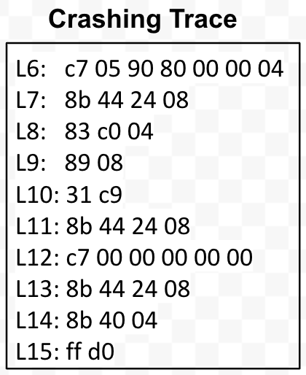
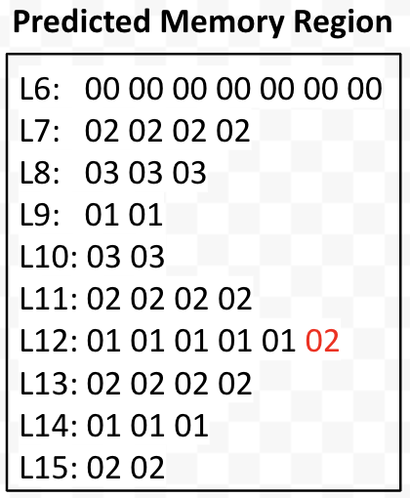
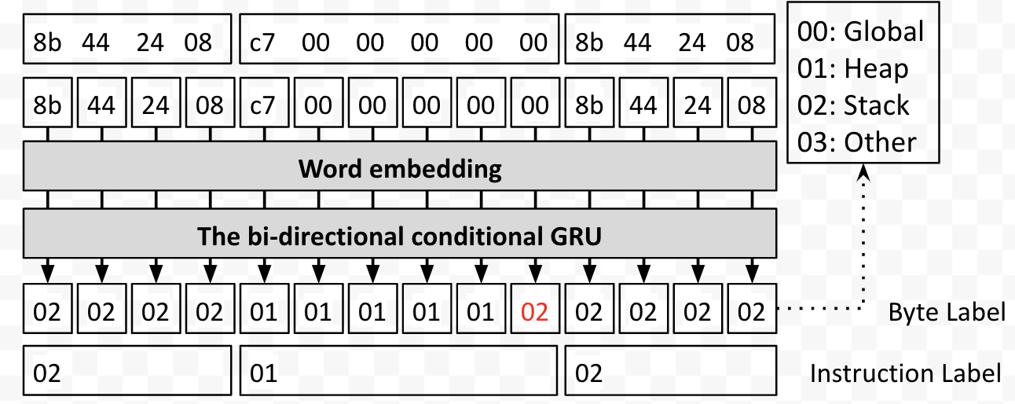
Our Solution – RENN
Motivate by the power of deep learning (DL) in binary analysis applications
Propose a novel sequence to sequence Recurrent Neural Network (seq2seq RNN) to predict coarse-grained memory regions accessed by instructions
Predict memory regions that the corresponding instruction may access
Notes:
To overcome the limitations mentioned before, we introduce deep learning techniques to solve this challenging problem because deep learning has shown its power in previous works, such as, “identifying function boundary in USENIX SEC 2015” and “recognize function type signatures in USENIX SEC 2017”.
Our solution proposes a novel sequence to sequence Recurrent Neural Network (seq2seq RNN) to predict coarse-grained memory regions accessed by instructions. At a high-level, our model takes a sequence of instructions (in binary format) as inputs and outputs a sequence of labels indicating the memory region that the corresponding byte (instruction) may access. As shown in the figure, we use a word embedding mechanism to map each byte into a vector and take this vector as the input. With our bi-directional conditional GRU, we predict the memory region accessed by the instruction. We will introduce the detail of our model later.

Slide 9
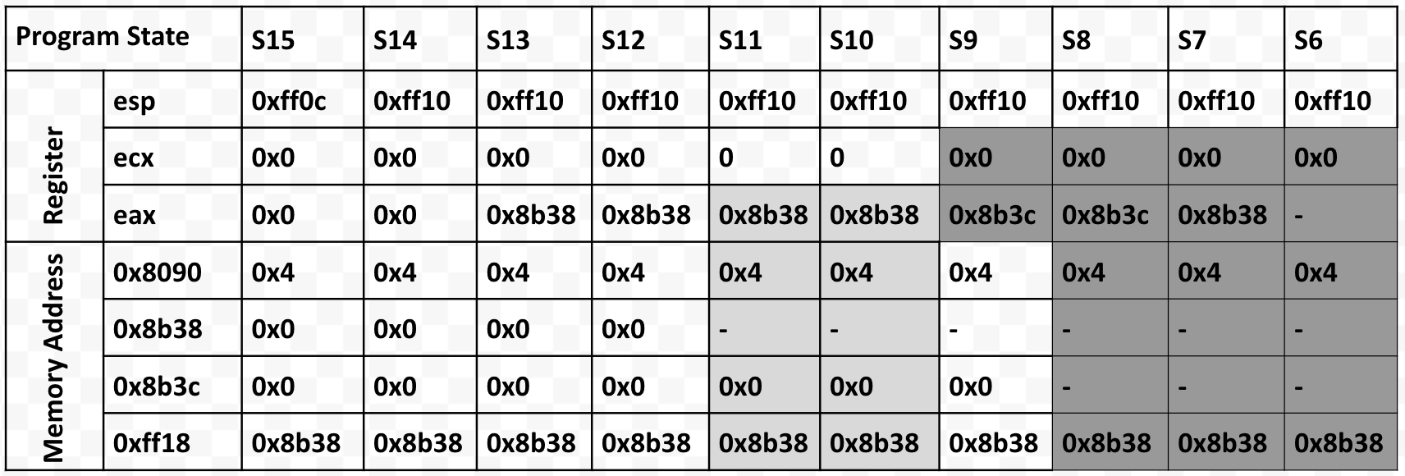
Our Solution – RENN (cont.)
Propose a novel sequence to sequence Recurrent Neural Network (seq2seq RNN) to predict coarse-grained memory regions accessed by instructions
If two instructions access different regions, we identify they are non-aliased. And this no-alias relationship could help recover more program state
Notes:
After predicting the memory regions, we leverage the memory regions to solve the memory alias issue – if two instructions access the same type of region, we assume they may be aliasing; otherwise, we assume they are non-aliasing. Furthermore, we leverage the identified non-alias relationship to help recover more program state and locate the root cause. From the figure in the bottom, we can infer [esp+0x8] in L7 is not aliased with [eax] in L9 as they refer to different regions. As a result, we could recover the memory state from S6-S9 and identify the root cause of this demo example.

Slide 10
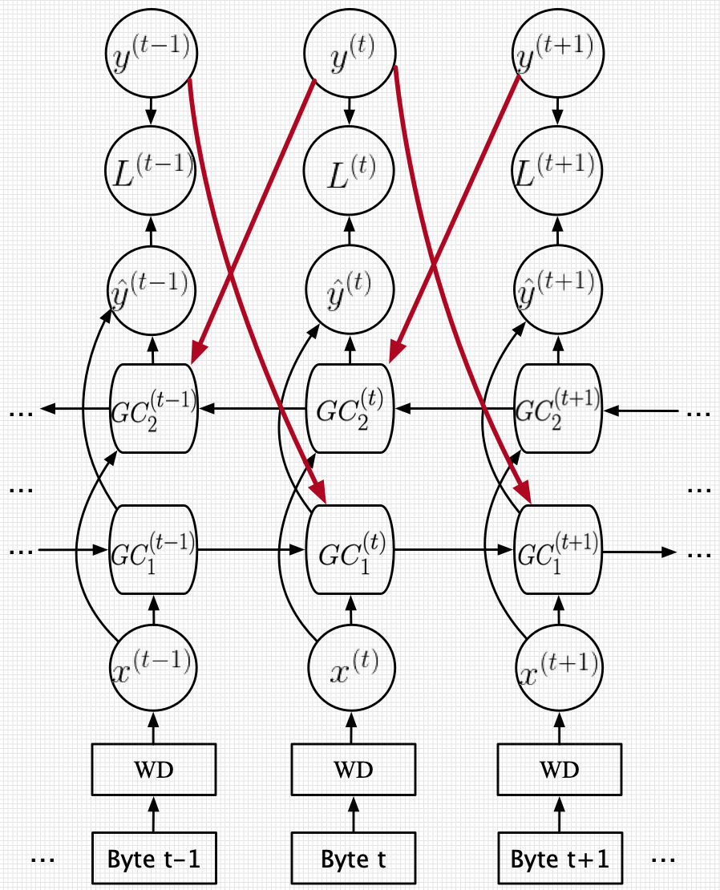
Model Architecture
Existing networks assume that the labels tied to bytes are conditionally independent from each other
Within instructions:
0: 89 04 24 mov [esp], eax
0: 8d 1c 24 lea ebx,[esp]
3: 89 0b mov DWORD PTR [ebx],ecx
Between instructions:
Considering the label dependence, we design a conditional bi-directional GRU to predict the region that an instruction accesses
Notes:
In this slide, I introduce some details of our model architecture. Since existing networks assume the labels are tied to bytes are conditionally independent from each other, they are not able to capture not only the dependency between and within instructions but also dependencies between adjacent labels.
To address this issue, we propose a conditional bi-directional GRU to predict the region that an instruction accesses. On one hand, a byte sequence in a binary is relatively long and with GRU we could capture long-term dependency with relatively low computational cost. On the other hand, this recurrent structure removes the conditional independent assumption, making our model capable of capturing label relationships in addition to the sequence dependency. More specially, the highlighted lines with red in the right figure help the bi-directional GRU capture the corresponding dependency.

Slide 11
Evaluation
We try to answer the following questions in this part :
Could our trained neural network correctly identify the memory regions which instructions access?
Could the identified memory regions improve the performance of reverse execution with respect to memory alias problem?
Could the identified memory regions enhance the root cause diagnosis of reverse execution?
Notes:
In the evaluation, we try to answer the following questions: 1. Could our trained neural network correctly identify the memory regions which instructions access? 2. Could the identified memory regions improve the performance of reverse execution with respect to memory alias problem? 3. Could the identified memory regions enhance the root cause diagnosis of reverse execution?

Slide 12
Experiment Design
Data Set used to train and test our RNN
Training Data Set (4.9M instructions generated from 78 programs)
Testing Data Set (1.5M instructions generated from 40 vulnerable programs)
Baseline Deep Learning Models
Bi-directional RNN
Bi-directional LSTM
Bi-directional GRU
CoreUtils
BinUtils
Notes:
To train our deep learning model, we collect various execution traces and the corresponding memory region(es) each instruction accesses from monitoring the execution of 78 programs. As such, we get nearly 5M instructions from 96 traces. We select 40 vulnerable programs, like coreutils, binutils, nginx, python, from online vulnerability database. Finally, we obtain 1.5M instructions from our tracing component. Furthermore, we found that there is only 14% functions overlap between the training and testing data set. Following, we set up the three baseline models(Bi-directional RNN, Bi-directional LSTM, Bi-directional GRU) to compare with our proposed model.

Slide 13
Experiment Results
Deep Learning Model Performance
Efficiency Improvement on Reverse Execution
Effectiveness on Root Cause Diagnosis
Notes:
After showing our experiment design, I will evaluate our proposed model in three aspects – Deep Learning Model Performance, Efficiency Improvement on Reverse Execution and Effectiveness on Root Cause Diagnosis.

Slide 14
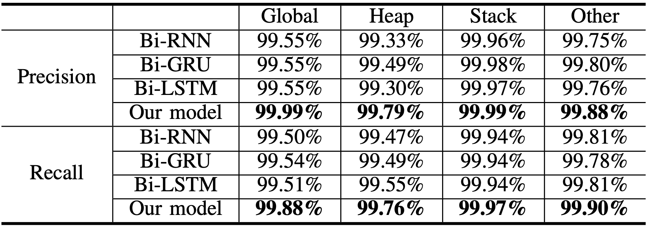
Experiment Results (cont.)
Deep Learning Model Performance
Efficiency Improvement on Reverse Execution
Effectiveness on Root Cause Diagnosis
In our scenario, the logged execution traces are relatively long. Small improvement in precision or recall could reduce the number of false positives or negatives by the thousands
Notes:
For Deep Learning Model Performance, the right table shows the precision and recall of various recurrent neural networks, regarding their capability of assigning correct memory regions to executed instructions. In our scenario, the logged execution traces are relatively long. Using a neural network with small improvement in precision or recall, we could reduce the number of false positives or negatives by the thousands.

Slide 15
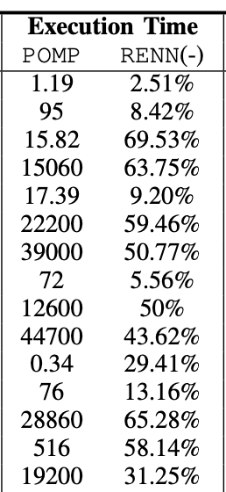
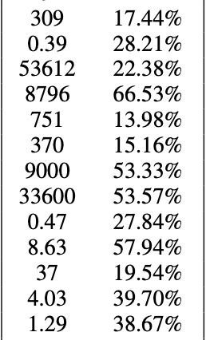
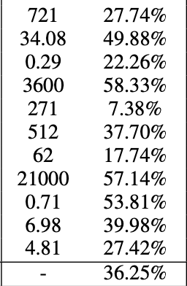
Experiment Results (cont.)
Deep Learning Model Performance
Efficiency Improvement on Reverse Execution
Effectiveness on Root Cause Diagnosis
Alias relationship verified: POMP : 58%, RENN : 79% (21%+)
Decrease 36% of execution time from POMP
Compared with POMP, RENN is more effective in finding the root cause of software crashes
 | RENN | POMP
Total # of cases in which we could diagnose the root cause | 37/40 | 31/40
Notes:
In terms of Efficiency Improvement on Reverse Execution and Effectiveness on Root Cause Diagnosis, at first, the percentage of identified non-alias pair is increased by 21% on average. Second, from our data statistics, we can see that, compared with POMP, the execution time of RENN is decreased by more than 36% on average. And some cases (e.g., prozilla, libtiff) could even save about 60% of execution time. Third, RENN could diagnose six more root causes than POMP, demonstrating that RENN is more effective in finding the root cause of software crashes.

Slide 16
Conclusion
Reverse Execution is highly impaired due to incomplete execution trace
RENN could facilitate reverse execution with alias analysis at binary level
RENN can significantly improve reverse execution with respect to its capability in resolving memory aliases and reducing execution time
Notes:
Our conclusion is as follows: Reverse Execution is highly impaired due to incomplete execution trace; RENN could facilitate reverse execution with alias analysis at binary level; RENN can significantly improve reverse execution with respect to its capability in resolving memory aliases and reducing execution time.

Slide 17
Q & A
Github Repo: https://github.com/mudongliang/RENN
Notes:
We have opened source our source code and data at GitHub. Thank you very much for joining my talk. And I am very happy to take questions.

